Slide 1
Overview of NoSQL Databases

Slide 2
Contents
Setting the scene for NoSQL
Types of NoSQL databases

Slide 3
1. Setting the Scene for NoSQL
Essential concepts: Relational databases
Strengths of relational databases
Limitations of relational databases
The role of NoSQL databases
NoSQL databases in the industry

Slide 4

Essential Concepts: Relational Databases
According to Wiki:
A relational database is a digital database whose organization is based on the relational model of data, as proposed by E. F. Codd in 1970.
The relational model organizes data into one or more tables of columns and rows, with a unique key identifying each row.
Relationships are a logical connection between different tables, established on the basis of interaction among these tables.
Virtually all relational database systems use SQL as the language for querying and maintaining the database.

Slide 5
Strengths of Relational Databases
Extremely well proven and widely used in the industry
E.g. Oracle, SQL Server, MySQL
Quality of service guarantees
Highly efficient, e.g. via indexes, load balancing, etc.
Highly available, e.g. via replication, fail-over, etc.
Highly secure
Transactional

Slide 6
Limitations of Relational Databases
Not good at storing unstructured or heterogeneous data
This kind of data doesn't fit nicely into the structured world of rectangular tables and fixed relationships
Not ideal for ingressing big data at high velocity
It takes time to break the data down into rectangular chunks, so that it can be inserted into table(s) in an RDBMS
Not good for rapidly evolving (agile) requirements
You can't keep changing the database schema all the time!
Not ideal for scale-out architectures
RDBMS aren't really designed for the cloud / commodity storage

Slide 7
The Role of NoSQL Databases
NoSQL is a general term to represent non-relational database management systems
Encompasses a wide variety of database technologies
NoSQL databases are designed to address the demands of building contemprary applications
Unstructured data
Handling big data
Data modelling agility
Scale-out architecture via auto-sharding, i.e. natively and automaticallty spread data across any number of servers

Slide 8
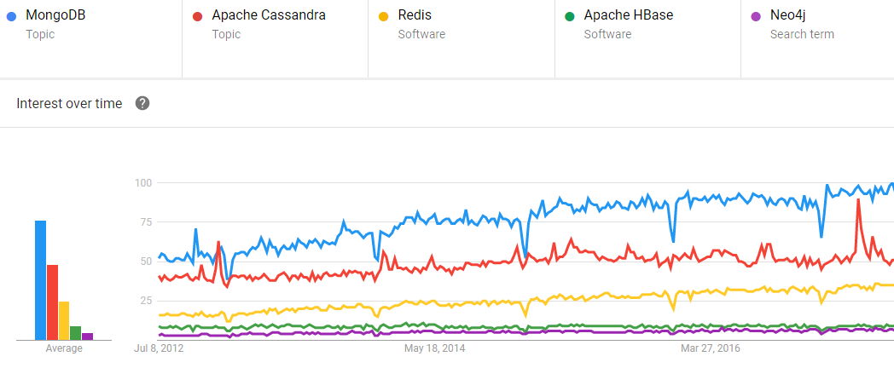
NoSQL Databases in the Industry
MongoDB is the top NoSQL database engine in use today
The following chart shows NoSQL usage stats
Data is taken from Google Trends, for the period 2012 - 2018

Slide 9
2. Types of NoSQL Databases
Key-value stores
Document-oriented databases
Column-oriented stores
Graph databases

Slide 10
Key-Value Stores
Description
The simplest type of NoSQL database
Each item in the database is stored as a key/value pair
Accessing data
Key lookups, like using a map or dictionary in an OO language
Examples of key-value stores
Redis
Oracle NoSQL Database

Slide 11
Document-Oriented Databases
Description
Stores documents of any schema
Uses encoding formats such as JSON, BSON, YAML, and XML
Each document has a unique key
Accessing data
Access documents by unique keys
Proprietary APIs to perform CRUD operations
Examples of document-oriented databases
MongoDB
MarkLogic

Slide 12
Column-Oriented Stores
Description
Stores data on disk by columns
All cells of a column are stored together on disk, which optimises many big-data manipulation scenarios
Accessing data
Proprietary APIs to perform CRUD operations, e.g. Cassandra has the Cassandra Query Language (CQL)
Examples of column-oriented stores
Apache Cassandra
HBase

Slide 13
Graph Databases
Description
Intended for data whose relations are well represented as a graph
Common use cases include fraud detection, real-time recommendation engines, network and IT operations, etc.
Accessing data
Graph-bases searches
APIs available in various standard programming languages such as Java, C++, Scala, and SPARQL
Examples of graph databases
Neo4j
ArangoDB

Slide 14
Any Questions?

